Slide 1
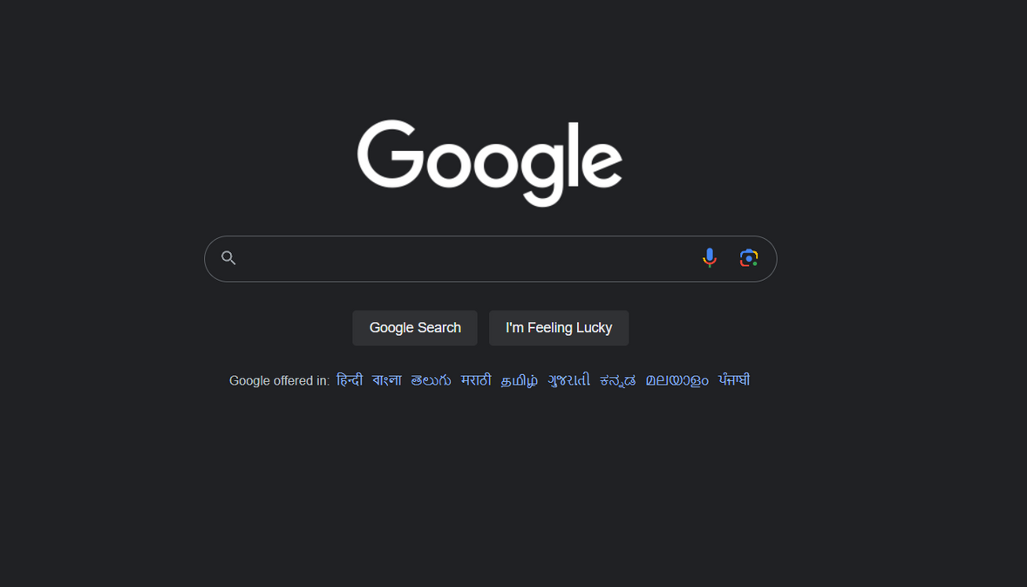





Slide 2


Slide 3
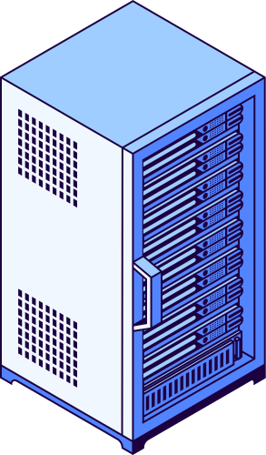

Request
Response
Google’s Server

Slide 4


HTML
Hyper Text
Markup Language
Uses hyperlinks to
navigate around the
web
Uses different tags to markup texts
<b>Hello</b>

